Slide 1
Regression Analysis
Regression Analysis in Practice
Nicoleta Serban, Ph.D.
Professor
Stewart School of Industrial and Systems Engineering
Emergency Department Healthcare Costs: Exploratory Data Analysis

Slide 2

About This Lesson

Slide 3
Exploratory Data Analysis: Response Variable
## Read the data using read.csv() R command
dataAdult = read.csv("DataADULT.csv", header=TRUE)
attach(dataAdult)
## Rescale outcome/response variable
EDCost.pmpm = EDCost/PMPM
## Rescale utilization
dataAdult$PO = PO/PMPM
dataAdult$HO = HO/PMPM
## Histogram of the response variable
par(mfrow=c(2,1))
hist(EDCost.pmpm, breaks=300, xlab="Emergency Department Cost", main="")
hist(log(EDCost.pmpm), breaks=300, xlab="Log-Emergency Department Cost", main="")

Slide 4
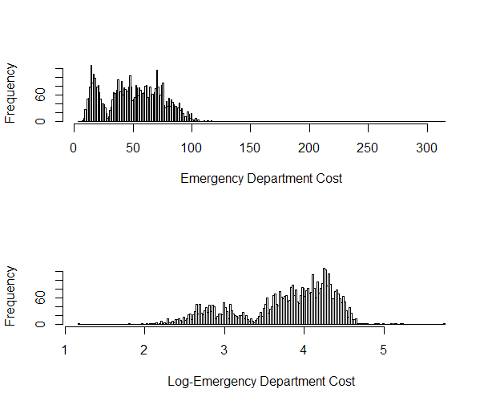
Exploratory Data Analysis: Response Variable

Slide 5
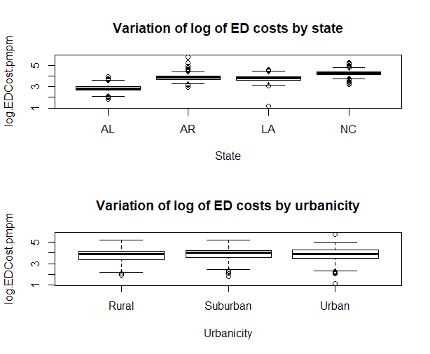
Exploratory Data Analysis: Response vs Qualitative Predictors
log.EDCost.pmpm = log(EDCost.pmpm)
## Response variable vs categorical predicating variables
par(mfrow=c(2,1))
boxplot(log.EDCost.pmpm ~ State, main = "Variation of log of ED costs by state")
boxplot(log.EDCost.pmpm ~ Urbanicity, main = "Variation of log of ED costs by urbanicity")

Slide 6
Exploratory Data Analysis: Response vs Qualitative Predictors
## Scatterplot matrix plots
library(car)
## Response vs Utilization
scatterplotMatrix(~ log(EDCost.pmpm) + HO + PO, smooth=FALSE)
## Response vs Population Characteristics
scatterplotMatrix(~ log(EDCost.pmpm) + WhitePop + BlackPop + OtherPop + HealthyPop +
ChronicPop + ComplexPop, smooth=FALSE)
## Response vs Socioeconomic and Environmental Characteristics
scatterplotMatrix(~ log(EDCost.pmpm) + Unemployment + Income + Poverty + Education +
Accessibility + Availability + ProvDensity, smooth=FALSE)
## Response vs County Health Rankings
scatterplotMatrix(~ log(EDCost.pmpm) + RankingsPCP + RankingsFood + RankingsHousing +
RankingsExercise + RankingsSocial, smooth=FALSE)

Slide 7
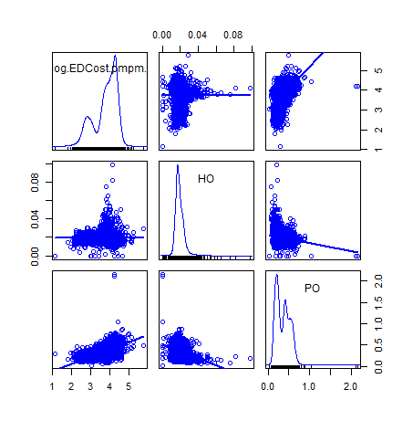
Response vs Quantitative Predictors
ED Cost vs. Utilization Measures: Number of Claims for HO and PO

Slide 8
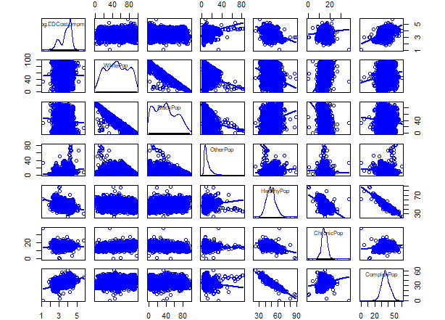
Response vs Quantitative Predictors
ED Cost vs. Population Characteristics: WhitePop, BlackPop, OtherPop, HealthyPop, ChronicPop, ComplexPop

Slide 9
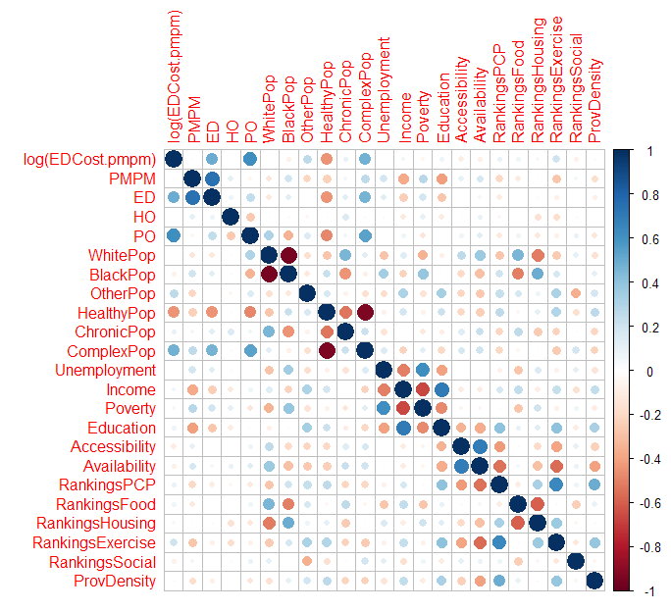
Response vs. Predicting Variables: Correlation Matrix Plot
## Correlation matrix plot
library(corrplot)
corr = cor(cbind(log(EDCost.pmpm), dataAdult[,-c(1, 2, 3, 18)]))
corrplot(corr)

Slide 10

Summary

